Slide 1



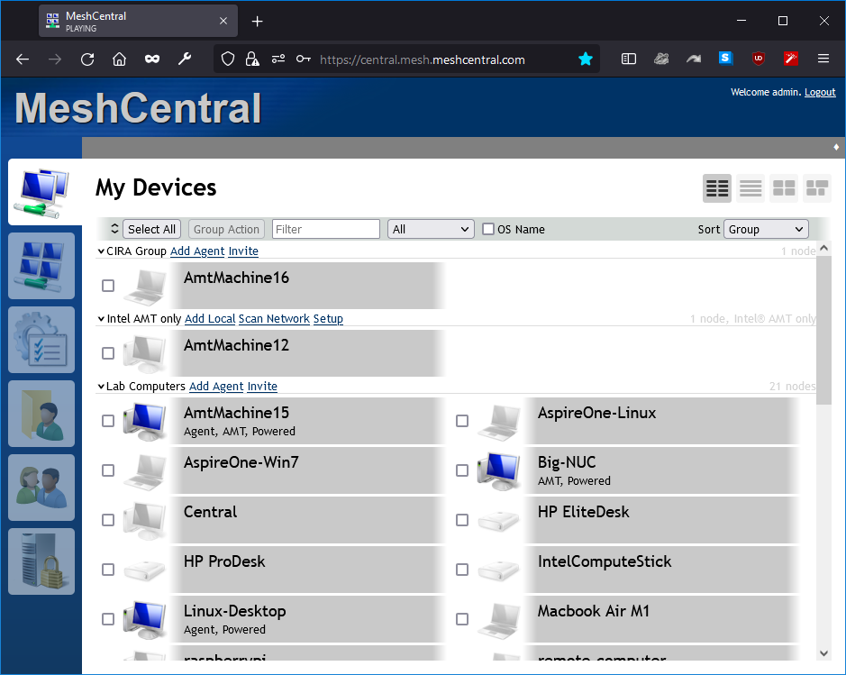


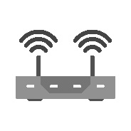

HTTP Proxy
Firewall
MeshCentral
Reverse Proxy
NAT
Router

Slide 2
PING
PONG
MeshCentral

Slide 3
PONG
MeshCentral

Slide 4
Config.json
{
"settings": {
"port": 443,
"BrowserPong": 120,
"AgentPong": 90
}
}

